Slide 1
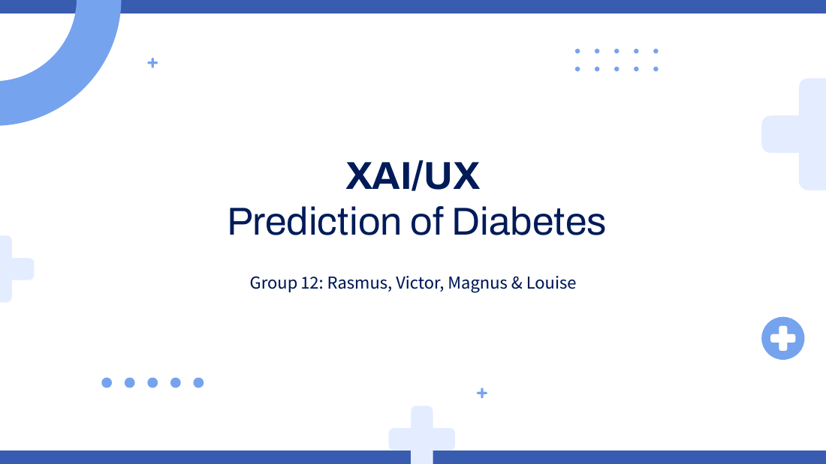
Patient conversation
XAI/UX
Understanding the result and choosing a next step
Group 12: Rasmus, Victor, Magnus & Louise
3 Patient / 1
Notes:
L
TID: 30 sekunder.
8 slides på10minutter. Tal empatisk og forklar få ting ad gangen. Casen er en anonymiseret survey-person, ikke en diagnosticeret tilstedeværende patient. Indled med at datasættet allerede angiver prædiabetes ELLER diabetes. Modellen skelner ikke mellem de to.
Source: neural_network.ipynb, uploaded 19 Oct 2026. Saved outputs, not a new model run.
Source: decision_tree.ipynb, uploaded 19 Oct 2026. Saved outputs, not a new model run.

Slide 2
Our information about you
Recorded information | Example person
Age | 65–69 years
Body mass index | 53
Blood pressure / cholesterol | Both reported high
General health | Fair
Daily barriers | Difficulty walking and cost barriers to care
What does this say about our prediction?
3 Patient / 3
Notes:
L
TID: 90 sekunder.
Bekræft oplysninger før fortolkning. Den registrerede person: kvinde65–69, BMI53, højt blodtryk og kolesterol, helbredfair, gangbesvær, har afstået lægehjælp pga økonomi. Inviter til korrektion uden skyld. Forklar at data ikke fortæller hele personens hverdag. Variable definitions: https://www.cdc.gov/brfss/annual_data/2015/pdf/codebook15_llcp.pdf ; https://archive.ics.uci.edu/dataset/891/cdc+diabetes+health+indicators
Source: neural_network.ipynb, uploaded 19 Oct 2026. Saved outputs, not a new model run.
Source: decision_tree.ipynb, uploaded 19 Oct 2026. Saved outputs, not a new model run.

Slide 3
What this result can tell you
Our prediction: It flags a pattern associated with prediabetes or diabetes.
The tool compares your answers with patterns in a survey.
It can be wrong, and it cannot tell your future with certainty.
A clinician can assess your situation and relevant blood tests.
3 Patient / 2
Notes:
V
TID: 75 sekunder.
Sig: værktøjet sammenligner oplysninger med mønstre i en tidligere undersøgelse. Det kan tage fejl. Det kan ikke vise fremtidig sygdom med88.5procents sandsynlighed. Diagnostik sker med sundhedsfaglig vurdering og relevante blodprøver. General clinical guidance: https://www.niddk.nih.gov/health-information/diabetes/overview/preventing-type-2-diabetes ; https://www.niddk.nih.gov/health-information/diabetes/overview/tests-diagnosis . Accessed 19 Oct 2026. These recommendations do not come from LIME or SHAP.
Source: neural_network.ipynb, uploaded 19 Oct 2026. Saved outputs, not a new model run.
Source: decision_tree.ipynb, uploaded 19 Oct 2026. Saved outputs, not a new model run.

Slide 4
Why the tool flagged this example
They explain the tool’s
score for this example.
Score points, not a predicted benefit from changing a factor. Other less relevant contributions have been left out.
3 Patient / 4
Notes:
R
TID: 90 sekunder.
Forenklet redigerbar grafik ud fra NN-celle18, ikke nyt modelresultat. Tre største positive bidrag: GenHlth .128003 BMI .099715 HighBP .058207. Ganges med100 giver12.8,10.0,5.8 points på modelscore. Vis ikke som risikoreduktion. Andre bidrag udelades her og er i original-figuren i backup. Forklar søjler kvalitativt: længere betyder større bidrag til værktøjets score. Patientvenlige labels erstatter featurekoder.
Source: neural_network.ipynb, uploaded 19 Oct 2026. Saved outputs, not a new model run.
Source: decision_tree.ipynb, uploaded 19 Oct 2026. Saved outputs, not a new model run.

Slide 5
Two models gave the same flag
Tool | Result for this example
Model 1 | Flags prediabetes or diabetes
Model 2 | Flags prediabetes or diabetes
Clinical test answer | Prediabetes or diabetes
Agreement does not replace a clinical assessment.
The data do not distinguish prediabetes from diabetes in this label.
3 Patient / 5
Notes:
TID: 90 sekunder.
Begge klassificerer57608 positivt. Brug ikke procentikon eller diagnosestempel. Den sande label1 er allerede registreret i datasættet. LIME/SHAP forklarer modellerne og kan ikke give ny diagnose. At to modeller er enige er ikke to uafhængige kliniske tests: de er trænet på samme data.
Source: neural_network.ipynb, uploaded 19 Oct 2026. Saved outputs, not a new model run.
Source: decision_tree.ipynb, uploaded 19 Oct 2026. Saved outputs, not a new model run.

Slide 6
A plan that fits your situation
Topic for your healthcare team | A practical starting point
Blood sugar status | Clarify whether the situation is prediabetes or diabetes
Movement | Find activity that fits your walking difficulties
Food and weight support | Agree on manageable changes with professional support
Access to care | Discuss costs and other barriers to follow-up
The model cannot calculate how much a change will help you.
3 Patient / 6
Notes:
M
TID: 90 sekunder.
Generel evidensbaseret vejledning fra NIDDK, ikke afledt af SHAP. Ved prædiabetes kan støttet vægthåndtering, kost og fysisk aktivitet forebygge/forsinke type2. Ved allerede diagnosticeret diabetes handler planen om behandling og opfølgning. Ingen specifik motion eller vægttabsprocent ordineres her pga alder, BMI53 og gangbesvær. Afstem aktivitet med kliniker. Spørg ind til omkostningsbarrierer. General clinical guidance: https://www.niddk.nih.gov/health-information/diabetes/overview/preventing-type-2-diabetes ; https://www.niddk.nih.gov/health-information/diabetes/overview/tests-diagnosis . Accessed 19 Oct 2026. These recommendations do not come from LIME or SHAP.
Source: neural_network.ipynb, uploaded 19 Oct 2026. Saved outputs, not a new model run.
Source: decision_tree.ipynb, uploaded 19 Oct 2026. Saved outputs, not a new model run.

Slide 7
What you do not need to change
Your age and sex are background information.
A model score is not a judgment about you.
Continue appropriate check-ups and prescribed care.
An explanation is not a reason to start drinking alcohol.
3 Patient / 7
Notes:
TID: 75 sekunder.
Ikke skyldgivende: alder og køn kan ikke ændres og er ikke handlinger. Indkomst er en kontekst/barriere og bør ikke fremstilles som patientens ansvar. LIME CholCheck og alkohol giver ikke medicinske råd. Undgå teknisk figur her. Den præcise retning af attributionsværdier skal ikke sættes lig klinisk effekt.
Source: neural_network.ipynb, uploaded 19 Oct 2026. Saved outputs, not a new model run.
Source: decision_tree.ipynb, uploaded 19 Oct 2026. Saved outputs, not a new model run.

Slide 8
Your next step and your questions
A conversation with your healthcare team
What does this result mean to you?
What would make follow-up difficult?
Which small, realistic step would you like support with?
3 Patient / 8
Notes:
L
TID: 60 sekunder.
Afslut med teach-back og fælles valg, ikke en quiz. Spørg hvad personen tager med sig og hvilke barrierer der skal håndteres. Bekræft at sundhedsråd kommer fra klinisk viden. Stop præsentationen ved10minutter og åbn10minutters spørgsmål. General clinical guidance: https://www.niddk.nih.gov/health-information/diabetes/overview/preventing-type-2-diabetes ; https://www.niddk.nih.gov/health-information/diabetes/overview/tests-diagnosis . Accessed 19 Oct 2026. These recommendations do not come from LIME or SHAP.
Source: neural_network.ipynb, uploaded 19 Oct 2026. Saved outputs, not a new model run.
Source: decision_tree.ipynb, uploaded 19 Oct 2026. Saved outputs, not a new model run.

Slide 9
Q&A: questions a patient may ask
Question | Evidence-based answer
Does 0.885 mean I will get diabetes? | No. It is a model score from a balanced survey dataset.
What change would lower my risk most? | This model cannot estimate treatment benefits. Plan changes with your healthcare team.
Can I ignore the result if I feel well? | The score cannot settle your health status. Discuss testing and follow-up with a clinician.
Q&A backup / 9
Notes:
BACKUP: uden for de 10 minutter.
Hold svar korte. Hvis personen allerede har diabetes, skift fra forebyggelse af debut til behandling og opfølgning. General clinical guidance: https://www.niddk.nih.gov/health-information/diabetes/overview/preventing-type-2-diabetes ; https://www.niddk.nih.gov/health-information/diabetes/overview/tests-diagnosis . Accessed 19 Oct 2026. These recommendations do not come from LIME or SHAP.
Source: neural_network.ipynb, uploaded 19 Oct 2026. Saved outputs, not a new model run.
Source: decision_tree.ipynb, uploaded 19 Oct 2026. Saved outputs, not a new model run.

Slide 10
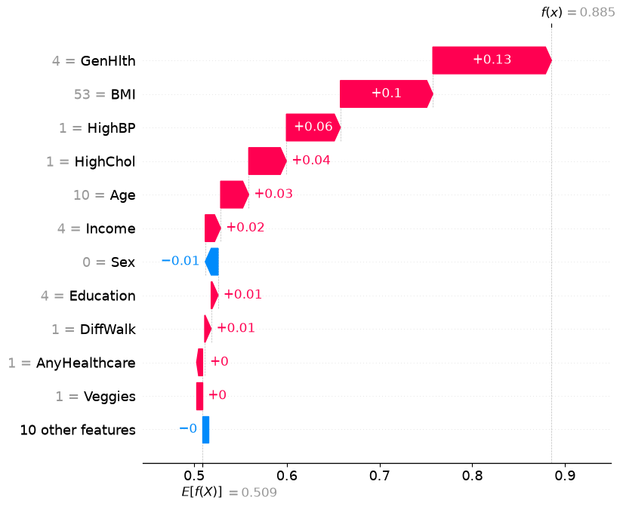
Backup: where the simple chart came from
The main explanation uses
the three largest upward
contributions from this plot.
The score reflects this
research model and its
reference data.
Q&A backup / 10
Notes:
V
BACKUP: uden for de 10 minutter.
Original NN-waterfall fra celle18. Brug kun hvis en patient efterspørger detaljer. Forklar én søjle ad gangen. Den forenklede hovedfigur viser tre største positive bidrag, mens originalen viser flere. Baseline ca.509 er gennemsnit af modelscore på50baggrundspersoner. Ingen kausal eller individuel fremtidig risikofortolkning.
Source: neural_network.ipynb, uploaded 19 Oct 2026. Saved outputs, not a new model run.
Source: decision_tree.ipynb, uploaded 19 Oct 2026. Saved outputs, not a new model run.

